Slide 1



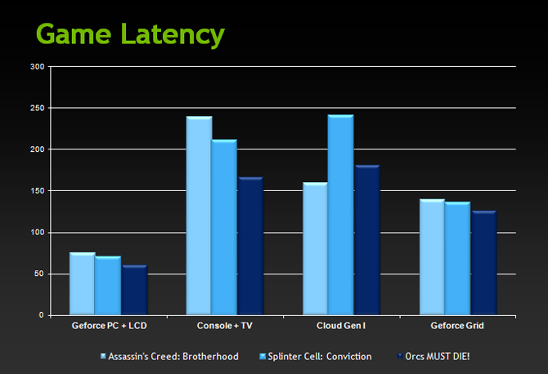
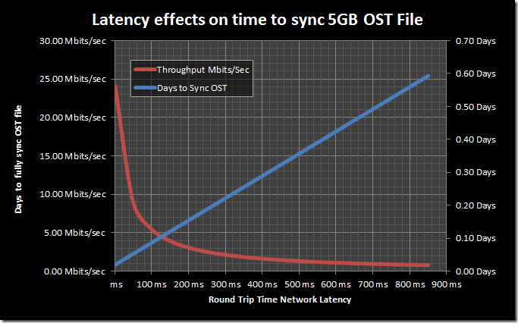
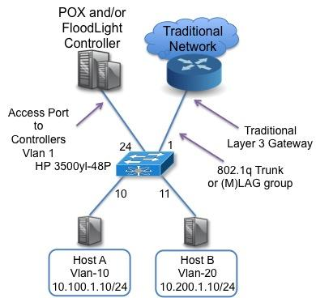
School of Computing & Information Sciences
VIP 4993 - U01 Spring 2017
Next Generation Networking 1.0
<Bradley Marzouka>, <Gabriel Taveras> >Florida International University
Mentor: <Professor Francisco Ortega>, <Professor>
Instructor: Masoud Sadjadi, Florida International University
Problem
The problem with current networks is their inability to handle high bandwidth applications while also being secure enough to protect data flows across the network.
Solution
Create an SDN network created with OpenFlow and secured by protocols such as FortNOX.
Current System
Use mininet to create a virtual machine that runs an SDN network to support the security and latency requirements of the clients.
Screenshots
Screenshots are to be relevant to the problem and solution statement.
Requirements
Be capable of not increasing latency more than current networks under heavy load.
Be capable of keeping all data secured across the network.
System Design
Implementation
Use mininet to create a virtual SDN network capable of securing the network from interference using OpenFlow combined with other protocols to both secure the network and reduce latency.
Verification
In the future we want to use mininet to create an SDN network capable of the specifications provided.
Object Design
We can set up an SDN controller that connects to hosts through the SDN switches. The clients will communicate with each other through the switches which will send data to the controller for processing.
Summary
Research and create an SDN network that can handle high bandwidth applications while keeping data secured throughout the network.
Acknowledgement
The material presented in this poster is based upon the work supported byProfessor Ortega. I am thankful to the help that I received from my group members Gabriel Taveras
Notes:
‹#›

